Slide 1

Compare K Nearest Neighbor and Decision Tree Model in Feature Selection with Mice Protein Expression Data Set
Wenkai Li, Student ID: s3815738
Contact details: s3815738@student.rmit.edu.au
Date of report: 02/06/2020
Notes:
In this study, I compared K Nearest Neighbor and Decision Tree Model in Feature Selection with Mice Protein Expression Data Set

Slide 2
Contents
Introduction
Research Goal
Data Set Description
Data preparation
Data Exploration
Data modelling
Results
Conclusion
Recommendation
Notes:
It has following contents.

Slide 3
1. Introduction
Down syndrome is a genetic disorder caused by extra copy of genes on chromosome 21
Overexpression of extra genes causes learning deficits in Down syndrome (Higuera, C., Gardiner, K. and Cios, K., 2015).
This experimental data set is collected by measuring protein expression of mice with different genotype, treatment, behavior and is classified into 8 classes. It contains expression levels of 77 mice proteins modifications and labels.

Slide 4
2. Research Goal
The research goal is to identify subsets of proteins that can discriminant between the 8 classes and compare these two classification models.

Slide 5
3. Data Set Description
There are 38 control mice and 34 Down syndrome mice.
Each mouse has a mouse ID.
Each protein per mouse has 15 measurements.
The measurements are expression levels of proteins modifications that produced signals in the nuclear fraction of cortex.
The dataset contains 1080 rows of measurements per protein and columns for 77 different proteins.
Four columns describe features include genotype for control or trisomy, behavior for context-shock or shock-context, treatment for memantine or saline injection and the 8 classes.
Totally, the data set is a 1080 * 82 data frame.

Slide 6
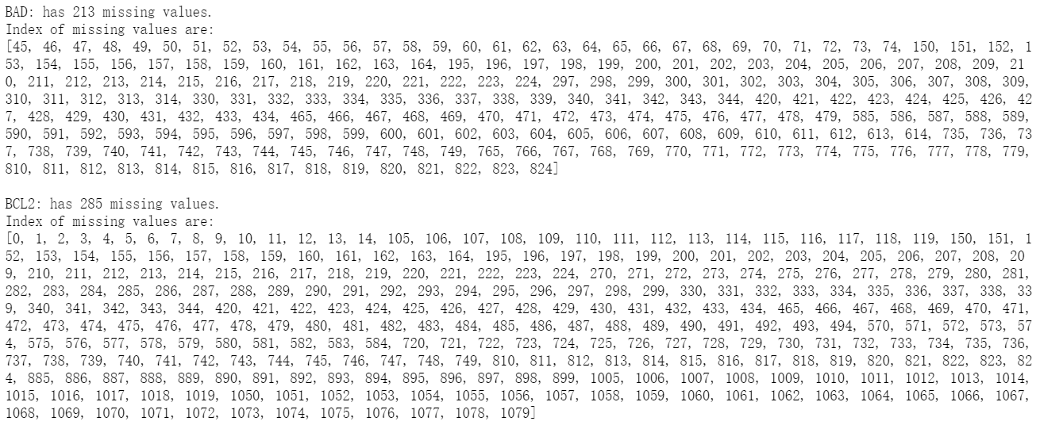
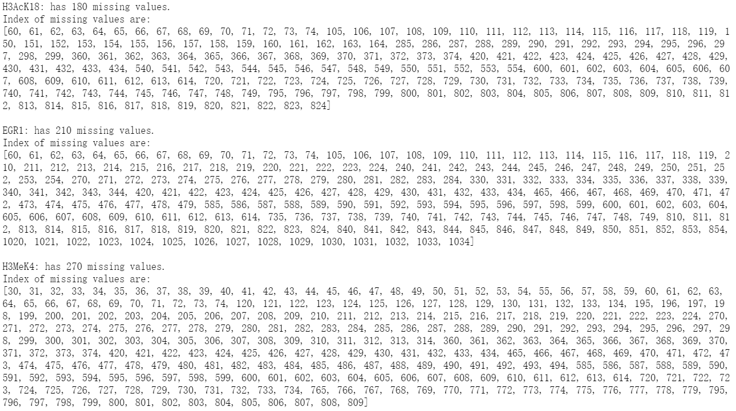
4. Data Preparation
Missing values:
In some columns there are high percentage of missing values.
These columns include BAD has 213 missing values, BCL2 has 285 missing values, H3AcK18 has 180 missing values, EGR1 has 210 missing values and H3MeK4 has 270 missing values.
Because each class might have different distributions, missing values were replaced by mean values of the same classes.
This is a method mentioned in one of the relevant papers (Higuera C, Gardiner KJ, Cios KJ ,2015).

Slide 7
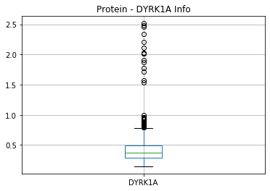
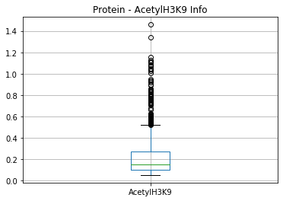
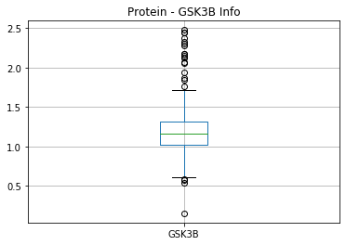
4. Data Preparation
Outliers:
Boxplot was used to visualize each protein column to check outliers.
Tukey`s method was used to detect outliers (Outliers, Wikipedia).
Then outliers are replaced by capping method (Anil D).

Slide 8
4. Data Preparation
Normalization:
The range of numeric columns are different.
Some range from 0 to 1, others range from 0 to 3.
Columns with higher range might influence more on the result of classifications (Higuera C, Gardiner KJ, Cios KJ ,2015).
All columns were normalized to range 0 to 1 using MinMaxScaler().

Slide 9
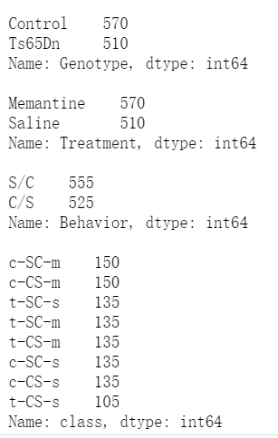
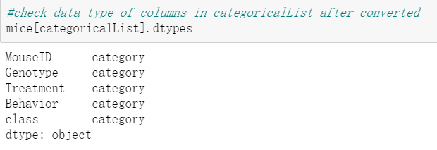
4. Data Preparation
Value Check:
Check unique values in description columns and converted them to categorical values with no order.
There are no typos nor impossible values in these columns.

Slide 10
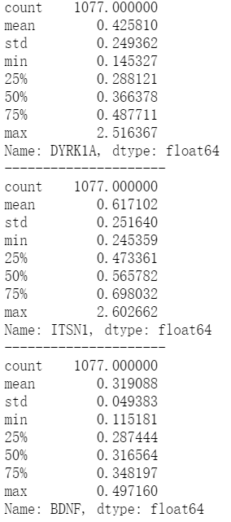
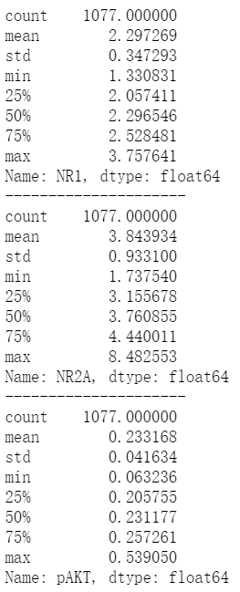
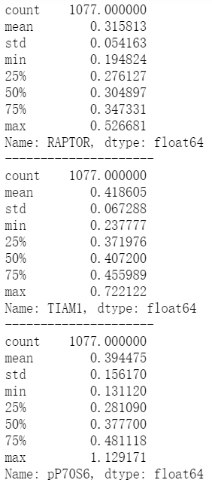
5. Data Exploration
Descriptive Statistics:
Each column are explored by checking descriptive statistics including mean, standard deviation, min value, max value and different quantiles.

Slide 11
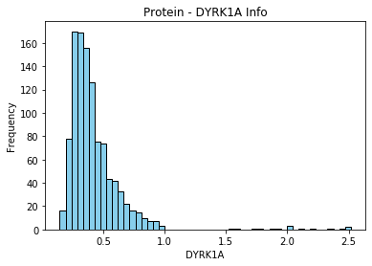
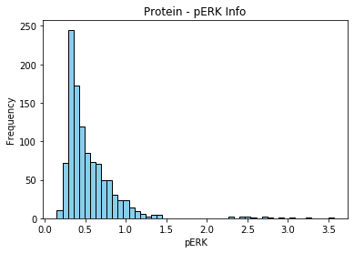
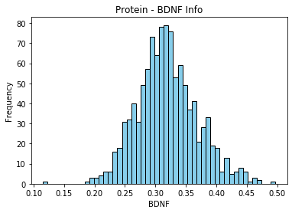
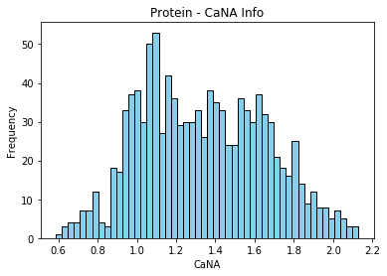
5. Data Exploration
Distribution:
Distributions of each column are explored by plotting histograms.

Slide 12
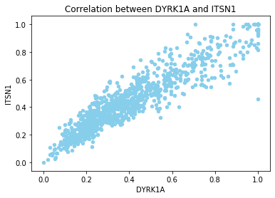
5. Data Exploration
Hypothesis 1: DYRK1A and ITSN1 have high correlation.
DYRK1A and ITSN1 are both chromosome 21 (Hsa21) proteins.
Overexpression of ITSN1 and DYRK1A leads to learning and memory deficits. (Higuera C, Gardiner KJ, Cios KJ ,2015).
As can be seen, they are showing a high positive correlation.
Notes:
By exploring the relationship between pairs of attributes, I had ten hypothesis.

Slide 13
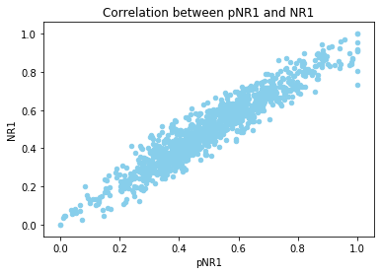
5. Data Exploration
Hypothesis 2: pNR1 and NR1 have high correlation.
NR1 is N-methyl-D-aspartate receptor (NMDAR) subunit and pNR1 is phosphorylated form of NR1 (Higuera C, Gardiner KJ, Cios KJ ,2015).
As can be seen, they are showing a high positive correlation.

Slide 14
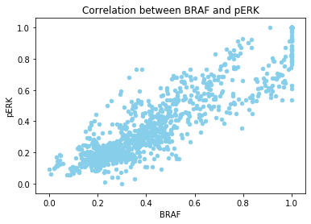
5. Data Exploration
Hypothesis 3: BRAF and pERK have high correlation.
BRAF and pERK are two components of the Mitogen-Activated Protein Kinase (MAPK) signaling pathway (Higuera C, Gardiner KJ, Cios KJ ,2015).
As can be seen, they are showing a high positive correlation.

Slide 15
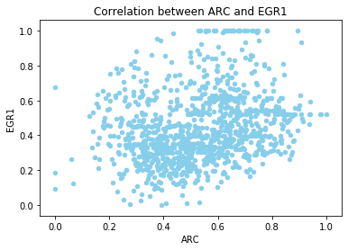
5. Data Exploration
Hypothesis 4: ARC and EGR1 have high correlation.
ARC and EGR1 are both immediate early gene proteins (IEG) (Higuera C, Gardiner KJ, Cios KJ ,2015).
However, they are not showing a high correlation.

Slide 16
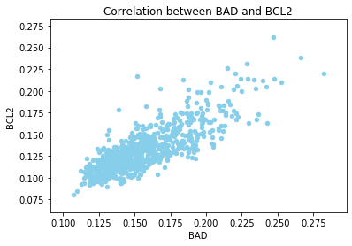
5. Data Exploration
Hypothesis 5: BAD and BCL2 have negative correlation.
Apoptotic is a form of programmed cell death that occurs in multicellular organisms (Apoptotic, Wikipedia).
BAD and BCL2 are both apoptosis related. BAD is proapoptotic while BCL2 is antiapoptotic (Higuera C, Gardiner KJ, Cios KJ ,2015).
However, as can be seen in the plot, they are showing a high positive correlation.

Slide 17
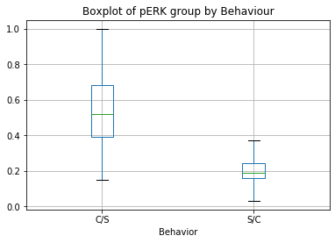
5. Data Exploration
Hypothesis 6: pERK is a good discriminant between Behaviors.
pERK plays an important role in learning and memory in both general and CFC (Higuera C, Gardiner KJ, Cios KJ ,2015).
As can be seen, measurement for pERK has a large difference between context-shock and shock-context. Values for C/S are much higher than S/C.

Slide 18
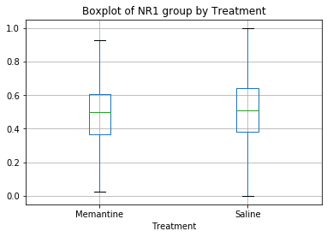
5. Data Exploration
Hypothesis 7: NR1 is a good discriminant between the Treatments.
Memantine is an antagonist of the N-methyl-D-aspartate receptor (NMDAR).
NMDAR subunit NR1, pNR1 plus pNUMB and pCAMKII are related to signaling from the NMDAR (Higuera C, Gardiner KJ, Cios KJ ,2015).
However, from the boxplot, we cannot see a large different between mean values of memantine and saline.

Slide 19
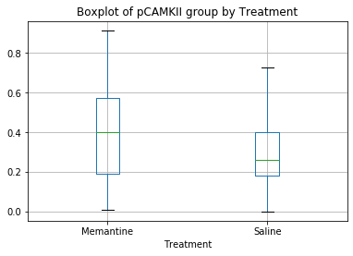
5. Data Exploration
Hypothesis 8: pCAMKII is a good discriminant between the Treatments.
pCAMKII is also related to signaling from the NMDAR (Higuera C, Gardiner KJ, Cios KJ ,2015).
As can be seen, mean value of saline is lower than that of memantine.

Slide 20
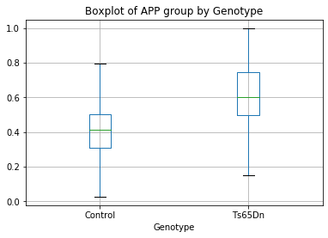
5. Data Exploration
Hypothesis 9: APP is a good discriminant between the Genotypes.
APP is a Hsa21 protein.
Ts65Dn mice have extra copy of genes on Hsa21 (Higuera C, Gardiner KJ, Cios KJ ,2015).
As can be seen, mean value of Ts65Dn is much higher than that of Control group.

Slide 21
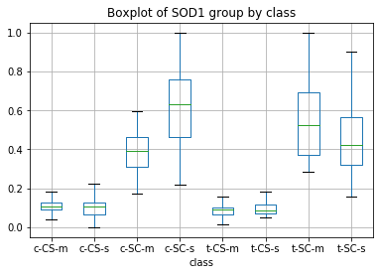
5. Data Exploration
Hypothesis 10: SOD1 plays an important role in discriminating the 8 classes.
SOD1 represents to superoxide dismutase. It is an Hsa21 protein and contributes to elevated levels of reactive oxygen species seen in Down Syndrome.
Overexpression of SOD1 in Ts65Dn mice leads to learning and memory deficits (Higuera C, Gardiner KJ, Cios KJ ,2015).
As Higuera C, Gardiner KJ and Cios KJ reported in the relevant paper, SOD1 level increases further in rescued learning and differed in the corresponding set of control mice in normal learning, c-CS-s vs. c-SC-s.
As can be seen, mean values of different classes are quite different, especially in classes c-SC-m, c-SC-s, t-SC-m, t-SC-s.

Slide 22
6. Data modelling
Selecting model:
As we have all the classes labeled, supervised learning algorithms are used to build the classifier.
In this research, I used and compared K Nearest Neighbor (KNN) and Decision Tree models.
Prepare training and testing subsets:
A subset “data” is defined to save protein columns.
A subset “target” is to save classes labels.
Data and target are then split into 4 subsets, two for training the model and two for testing the model.

Slide 23
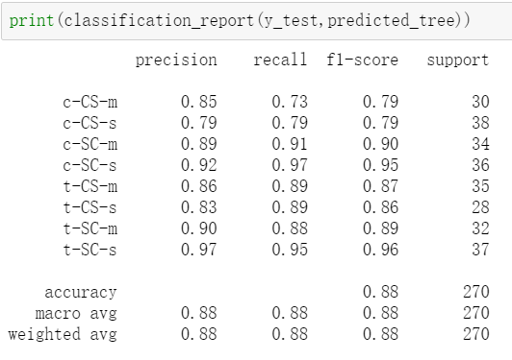
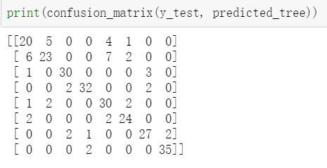
6. Data modelling
Model training, parameter tuning and validation:
I used KNeighborsClassifier imported from sklearn to build the KNN model DecisionTreeClassifier imported from sklearn to build the Decision Tree model.
Present the model with train dataset. After training the model, present the model with test subset to predict labels.
Compare predict labels with correct labels.
Then use evaluation metrics include confusion matrix, precision, recall rate and f1-score to validate the model.
Change parameters for the classifier.
Repeat the steps in data modelling and compare the evaluation scores to optimize the model.

Slide 24
6. Data modelling
Hill climbing for feature selection:
A light version of hill climbing is used to select most important features.
The model I used is the best performing model I trained from model validation.
It examines the neighboring features one by one and selects the first neighboring feature which optimizes the current cost as next feature. (Tutorial week 5)
The process will end if adding new column would not improve the highest score.
Selected features are printed to show the results.

Slide 25
7. Results
Results of KNN:
By using the tuned KNN classifier and hill climbing technic, 20 proteins were selected with precision and recall rate both equal to 1.0.
The 20 proteins in alphabet order are AcetylH3K9, BAD, BCL2, CREB, EGR1, ERBB4, GluR4, IL1B, JNK, MEK, MTOR, NR1, NR2B, P3525, P38, S6, Tau, pCAMKII, pCASP9, pGSK3B, pP70S6.
The final parameters I set are n_neighbors = 3, weights = 'distance', p = 1.

Slide 26
7. Results
Results of Decision Tree:
By using the tuned Decision Tree classifier and hill climbing technic, 29 proteins were selected with precision equal to 0.83 and recall rate equal to 0.82.
The 29 proteins in alphabet order are ADARB1, BAD, BAX, BCL2, CAMKII, CREB, DSCR1, EGR1, ERBB4, ERK, GluR3, GluR4, H3AcK18, IL1B, JNK, NR1, NUMB, P38, PKCA, S6, SHH, SOD1, pBRAF, pCAMKII, pCASP9, pGSK3B_Tyr216, pMTOR, pP70S6, pPKCAB.
The final parameters I set are default.
The results of decision tree are not stable. It changes when running different times.

Slide 27
8. Discussion
KNN is sensitive to outliers and scales differences.
A disadvantage of decision tree is overfitting
when using decision tree with continues numeric variables, it divides continues variables into bins. As a result, it might cause information loose when it categorizes variables.
Variables in this data set are continues, which might be a reason why KNN performs better.

Slide 28
9. Conclusion
The numbers of features selected by KNN is less than features selected by decision tree.
KNN has higher precision, recall rate and accuracy score.
KNN is recommended for this study regarding to project goal and accuracy.
Decision tree visualization can be used to illustrate which proteins influence more than others by checking nodes and splits.

Slide 29
References
Archive.ics.uci.edu. 2020. UCI Machine Learning Repository: Mice Protein Expression Data Set. [online] Available at: <https://archive.ics.uci.edu/ml/datasets/Mice+Protein+Expression> [Accessed 2 June 2020].
Wikipedia.org. 2020. Down Syndrome. [online] Available at: <https://en.wikipedia.org/wiki/Down_syndrome> [Accessed 2 June 2020].
Wikipedia.org. 2020. Memantine. [online] Available at: <https://en.wikipedia.org/wiki/Memantine> [Accessed 2 June 2020].
Wikipedia.org. 2020. Mouse Models of Down Syndrome. [online] Available at: <https://en.wikipedia.org/wiki/Mouse_models_of_Down_syndrome> [Accessed 2 June 2020].
Peter Curzon, Nathan R. Rustay, and Kaitlin E. Browman., 2009. Methods of Behavior Analysis in Neuroscience. 2nd ed. Chapter 2Cued and Contextual Fear Conditioning for Rodents. CRC Press. <https://www.ncbi.nlm.nih.gov/books/NBK5223/>
Wikipedia.org. 2020. Outlier. [online] Available at: <https://en.wikipedia.org/wiki/Outlier#Tukey's_fences> [Accessed 2 June 2020].
Higuera, C., Gardiner, K. and Cios, K., 2015. Self-Organizing Feature Maps Identify Proteins Critical to Learning in a Mouse Model of Down Syndrome. PLOS ONE, 10(6), p.e0129126.
Wikipedia.org. 2020. Apoptosis. [online] Available at: <https://en.wikipedia.org/wiki/Apoptosis> [Accessed 2 June 2020].
Scikit-learn.org. 2020. Sklearn.Tree.Decisiontreeclassifier — Scikit-Learn 0.23.1 Documentation. [online] Available at: <https://scikit-learn.org/stable/modules/generated/sklearn.tree.DecisionTreeClassifier.html?highlight=decision%20tree#sklearn.tree.DecisionTreeClassifier> [Accessed 2 June 2020].
Raileanu, L. and Stoffel, K., 2004. Theoretical Comparison between the Gini Index and Information Gain Criteria. Annals of Mathematics and Artificial Intelligence, 41(1), pp.77-93.
Raschka, S., 2020. Rasbt/Python-Machine-Learning-Book. [online] GitHub. Available at: <https://github.com/rasbt/python-machine-learning-book/blob/master/faq/decision-tree-binary.md> [Accessed 2 June 2020].
Anil Dolgun, Lecture Notes, Data Preprocessing, MATH2349
Yongli Ren, Lecture Notes, Practical Data Science with Python, COSC2670

